Slide 1
STUDENT PROJECT MANAGEMENT SYSTEM
GUIDED BY: DONE BY:
DR.C.KAVITHA M.Sc.,M.C.A.,Ph.D., DHANESH.K
ASSISTANT PROFESSOR

Slide 2
ABSTRACT:
The student project management system is a web-based application designed to streamline the management of student projects in an educational institution.
The system provides a centralized platform for students, faculty, and administrators to access and update project information.
The system allows students to submit project proposals, monitor the progress of their projects, and collaborate with mentors.
Faculty members can review and approve project proposals, and monitor the overall progress of student projects.
Administrators have the ability to manage users accounts, generate reports on project performance.
The system is also customizable to meet the specific needs and requirements of the educational institution.

Slide 3
SYSTEM REQUIREMENTS:
COMPONENTS | REQUIREMENTS
PROCESSOR | 11th Gen Intel(R) Core(TM) i5-1135G7 @ 2.40GHz 2.42 GHz
RAM | 8GB
HARDDISK DRIVE | 1TB
CACHE MEMORY | 2MB
COMPONENTS | REQUIREMENTS
OPERATING SYSTEM | Windows 10
FRONT END | Python
BACK END | MySql
HARDWARE SPECIFICATION
SOFTWARE SPECIFICATION

Slide 4
MODULES:
Staff login
Student login
AdMIN LOGIN

Slide 5
MODULE DESCRIPTION:
Staff login:
This module handles the staff login functionality.
It prompts the staff member to enter their username and password.
Allows staff members (project guides) to log in using their credentials.
Provides a dashboard for staff members to view and update their personal information. Allows staff members to view the list of projects assigned to them as guides.
Enables staff members to provide feedback and suggestions for the assigned projects.
Allows staff members to review and evaluate the progress and final submission of the projects they are guiding.

Slide 6
STUDENT LOGIN
This module handles the student login functionality.
It prompts the student to enter their username and password.
This module handles the addition and updating of student project details.
Allows students to log in using their unique student roll number.
Enables students to submit their mini/major project details, including the project title, description, and project guide.

Slide 7
ADMIN LOGIN
ALLOWS ADMINISTRATORS TO LOG IN USING THEIR CREDENTIALS.
ADMINISTRATORS TO MANAGE STUDENT AND STAFF INFORMATION.
ENABLES ADMINISTRATORS TO ASSIGN PROJECT GUIDES TO STUDENTS.
ALLOWS ADMINISTRATORS TO GENERATE REPORTS AND SUMMARIES REGARDING PROJECT PROGRESS, EVALUATION, ETC.
PROVIDES SETTINGS AND CONFIGURATIONS MANAGEMENT FOR THE SYSTEM.

Slide 8
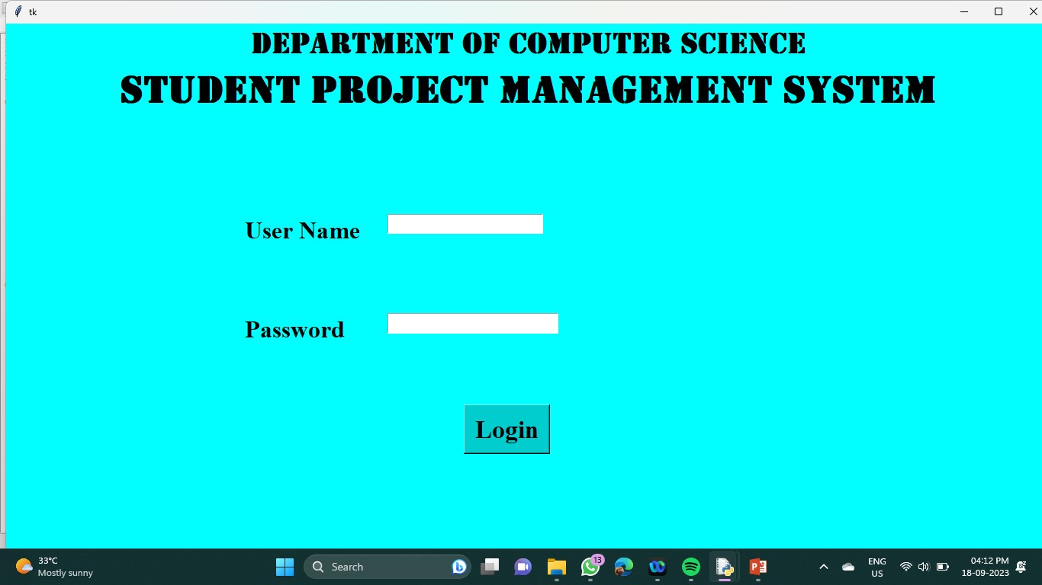
SCREENSHOTS:
LOGIN PAGE:

Slide 9
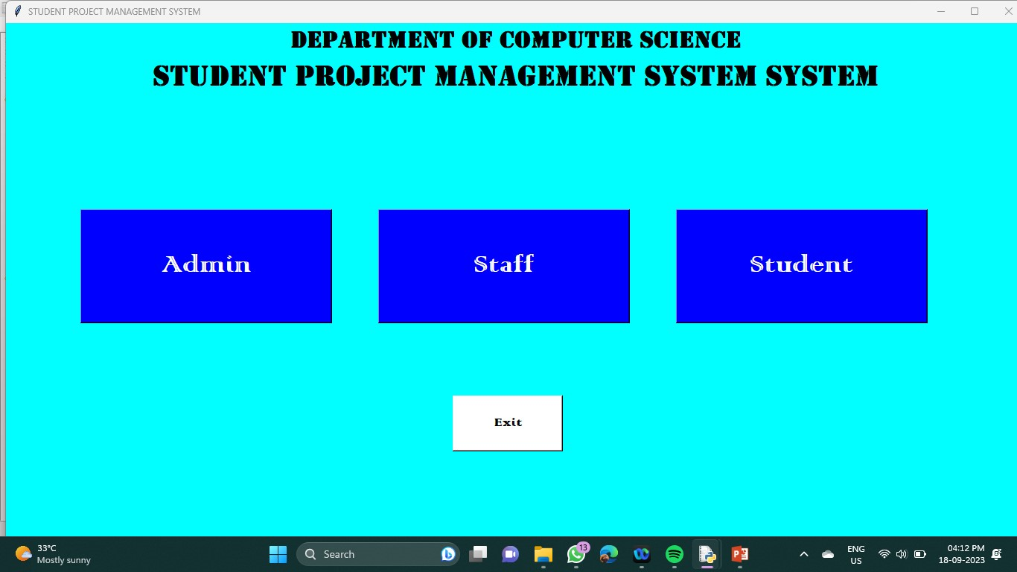
HOME PAGE:

Slide 10
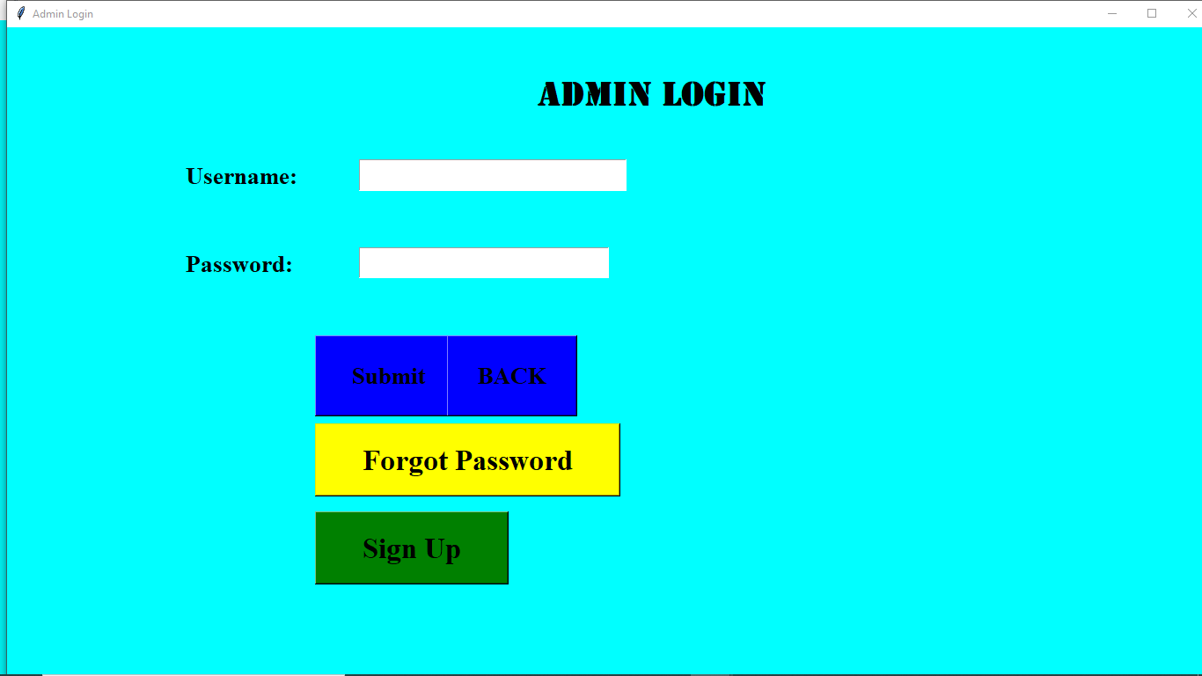
ADMIN LOGIN:

Slide 11
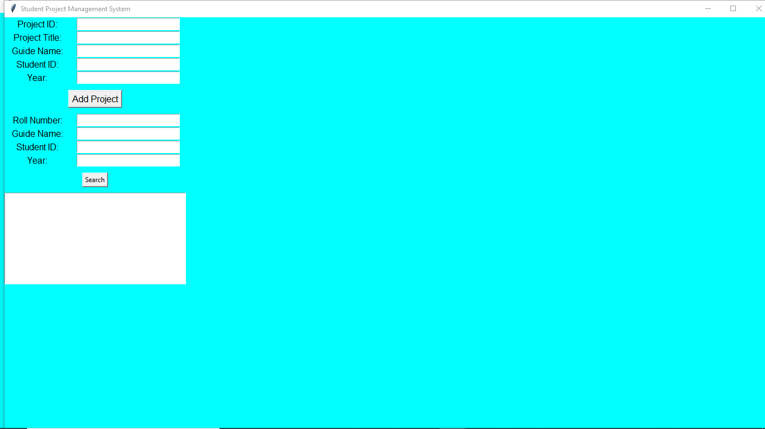
ADMIN LOGIN:

Slide 12

STAFF LOGIN:

Slide 13
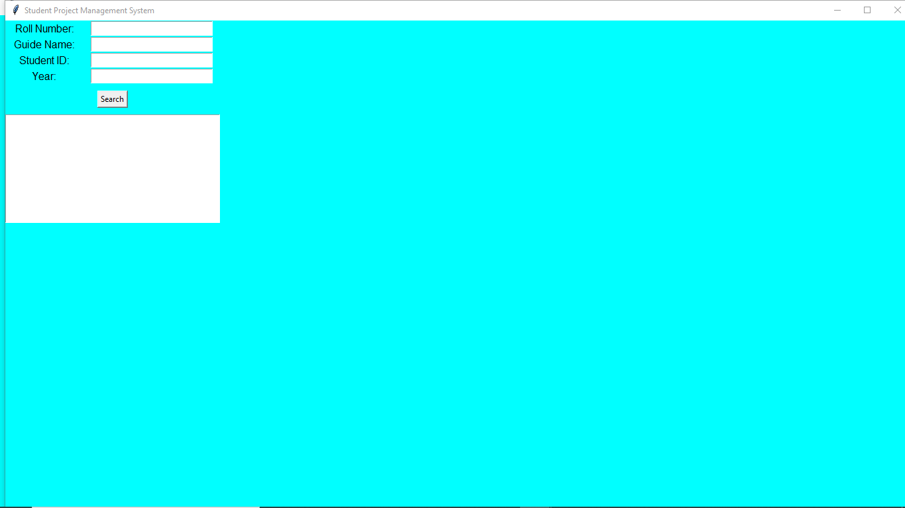
STAFF LOGIN:

Slide 14

STUDENT LOGIN:

Slide 15
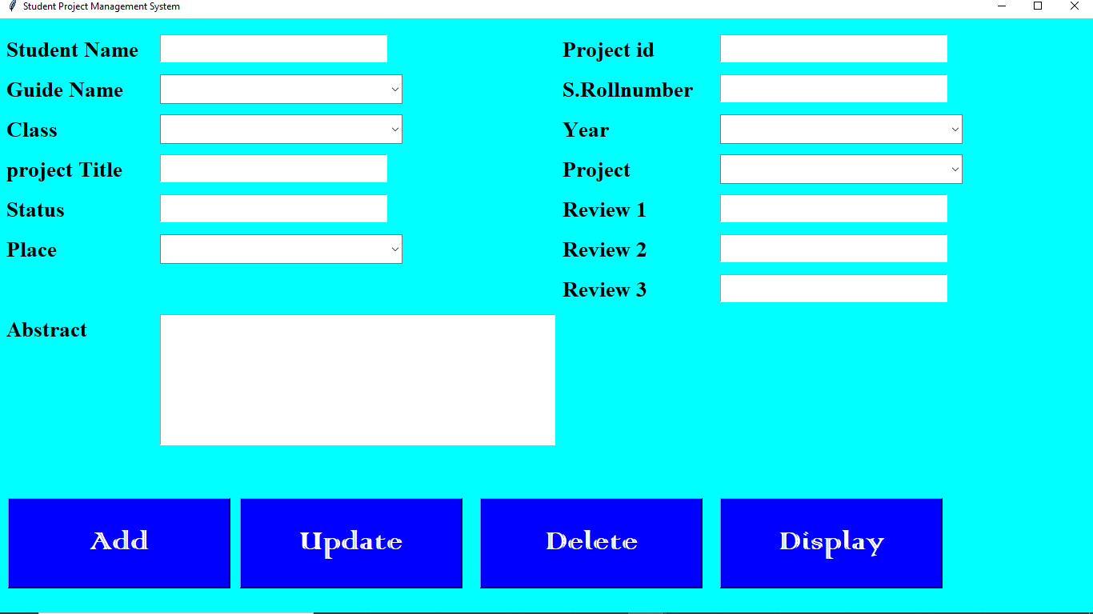
STUDENT LOGIN:

Slide 16
THANK YOU…

